Slide 1
Headcounts on steroids
A lightweight method for evaluating space and furniture use
Katherine Gerwig & Carolyn Bishoff
Library Assessment Conference 2018, Houston TX

Slide 2
For the next fifteen minutes...
Making library spaces talk
How we made our library space talk
What our library told us
How we used the data
Notes:
The smallest chunks represent 3 min. Present to see animation.

Slide 3
Making library spaces talk
How we made our library space talk
What our library told us
How we used the data
Notes:
Making library spaces talk (Introduction section)

Slide 4
Libraries like to study their spaces.

Slide 5
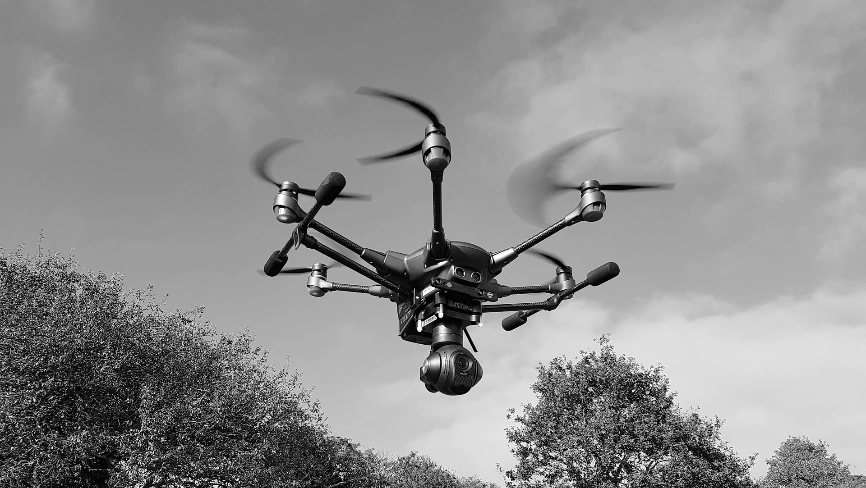
Observational
Qualitative
High tech
No tech
Notes:
Developing an understanding of user interactions with library spaces has prompted a number of user-focused studies in the library literature. The most simple method used to obtain baseline information on human-environment interactions is a passive observational study (Sussman, 2016). Observational studies use a wide range of methods. They may include counts by room and furniture type or divide spaces into artificially defined zones (Applegate, 2009; Leckie, Given, & Buschman, 2003; Gullickson, Meyer, & Meyer, 2016; Fox & Doshi, 2013). Observational studies can employ the use of paper maps, mobile apps, or even GIS mapping software (Thompson, 2015; Given & Archibald, 2015).
Observational studies often use a mixed-methods approach to create a more complete picture of user activity and perceptions, incorporating surveys, photo diaries, mapping exercises, or whiteboard comments (Dominguez, 2016; Fox & Doshi, 2013; Holder & Lange, 2014). A mixed-methods approach can also provide qualitative in formation about what users want out of a space (Fox & Doshi, 2013; Cha & Kim, 2015; Harrop & Turpin, 2013). Libraries have used a variety of methods to design learning spaces and gather feedback from potential users including observations, interviews, usability tests, environmental scans, ideal-space design exercises, and focus groups (Andrews, Wright, & Raskin, 2016).

Slide 6
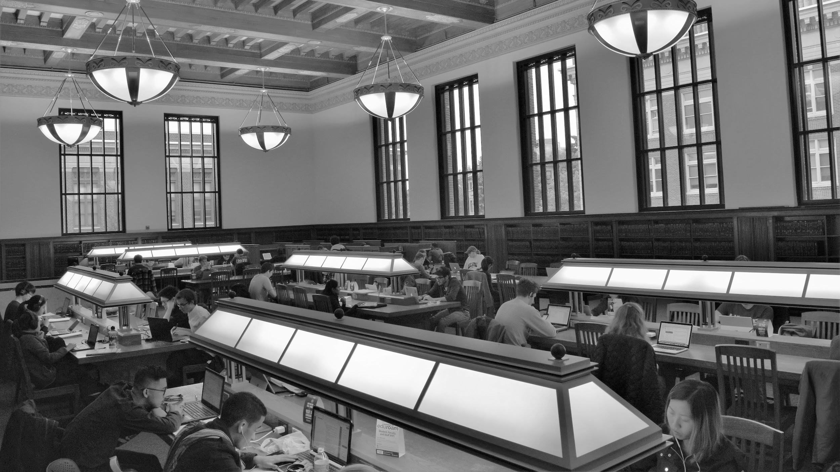
Walter is BIG.
469 seats are located on the second floor.
Notes:
Walter Library is a library on the University of Minnesota Twin Cities campus that has undergone a significant transition from collection storehouse to student learning space and contains many spaces that support collaboration, communal use, and semi-private work. Opened to the public in 1924, Walter Library is the oldest library on campus. The lobby and second floor have marble walls, beautiful ornate ceilings, marble columns, and frescoes above the door ways. The library houses the physical science and engineering collections but much of the collections were moved to storage during a renovation completed in 2002. It has huge areas devoted to individual and group study space and is centrally located on campus, which contributes to the large numbers of students who use the library.
The ornate grandeur and historical status of these areas mean there are restrictions on what staff can and cannot do to modify the space. The major study areas on the second floor are huge rooms with vaulted ceilings. Two of these rooms contain heavy wooden tables that are hard-wired into the floor and require a crane to move. Careful thought is required before asking to change things in Walter.

Slide 7
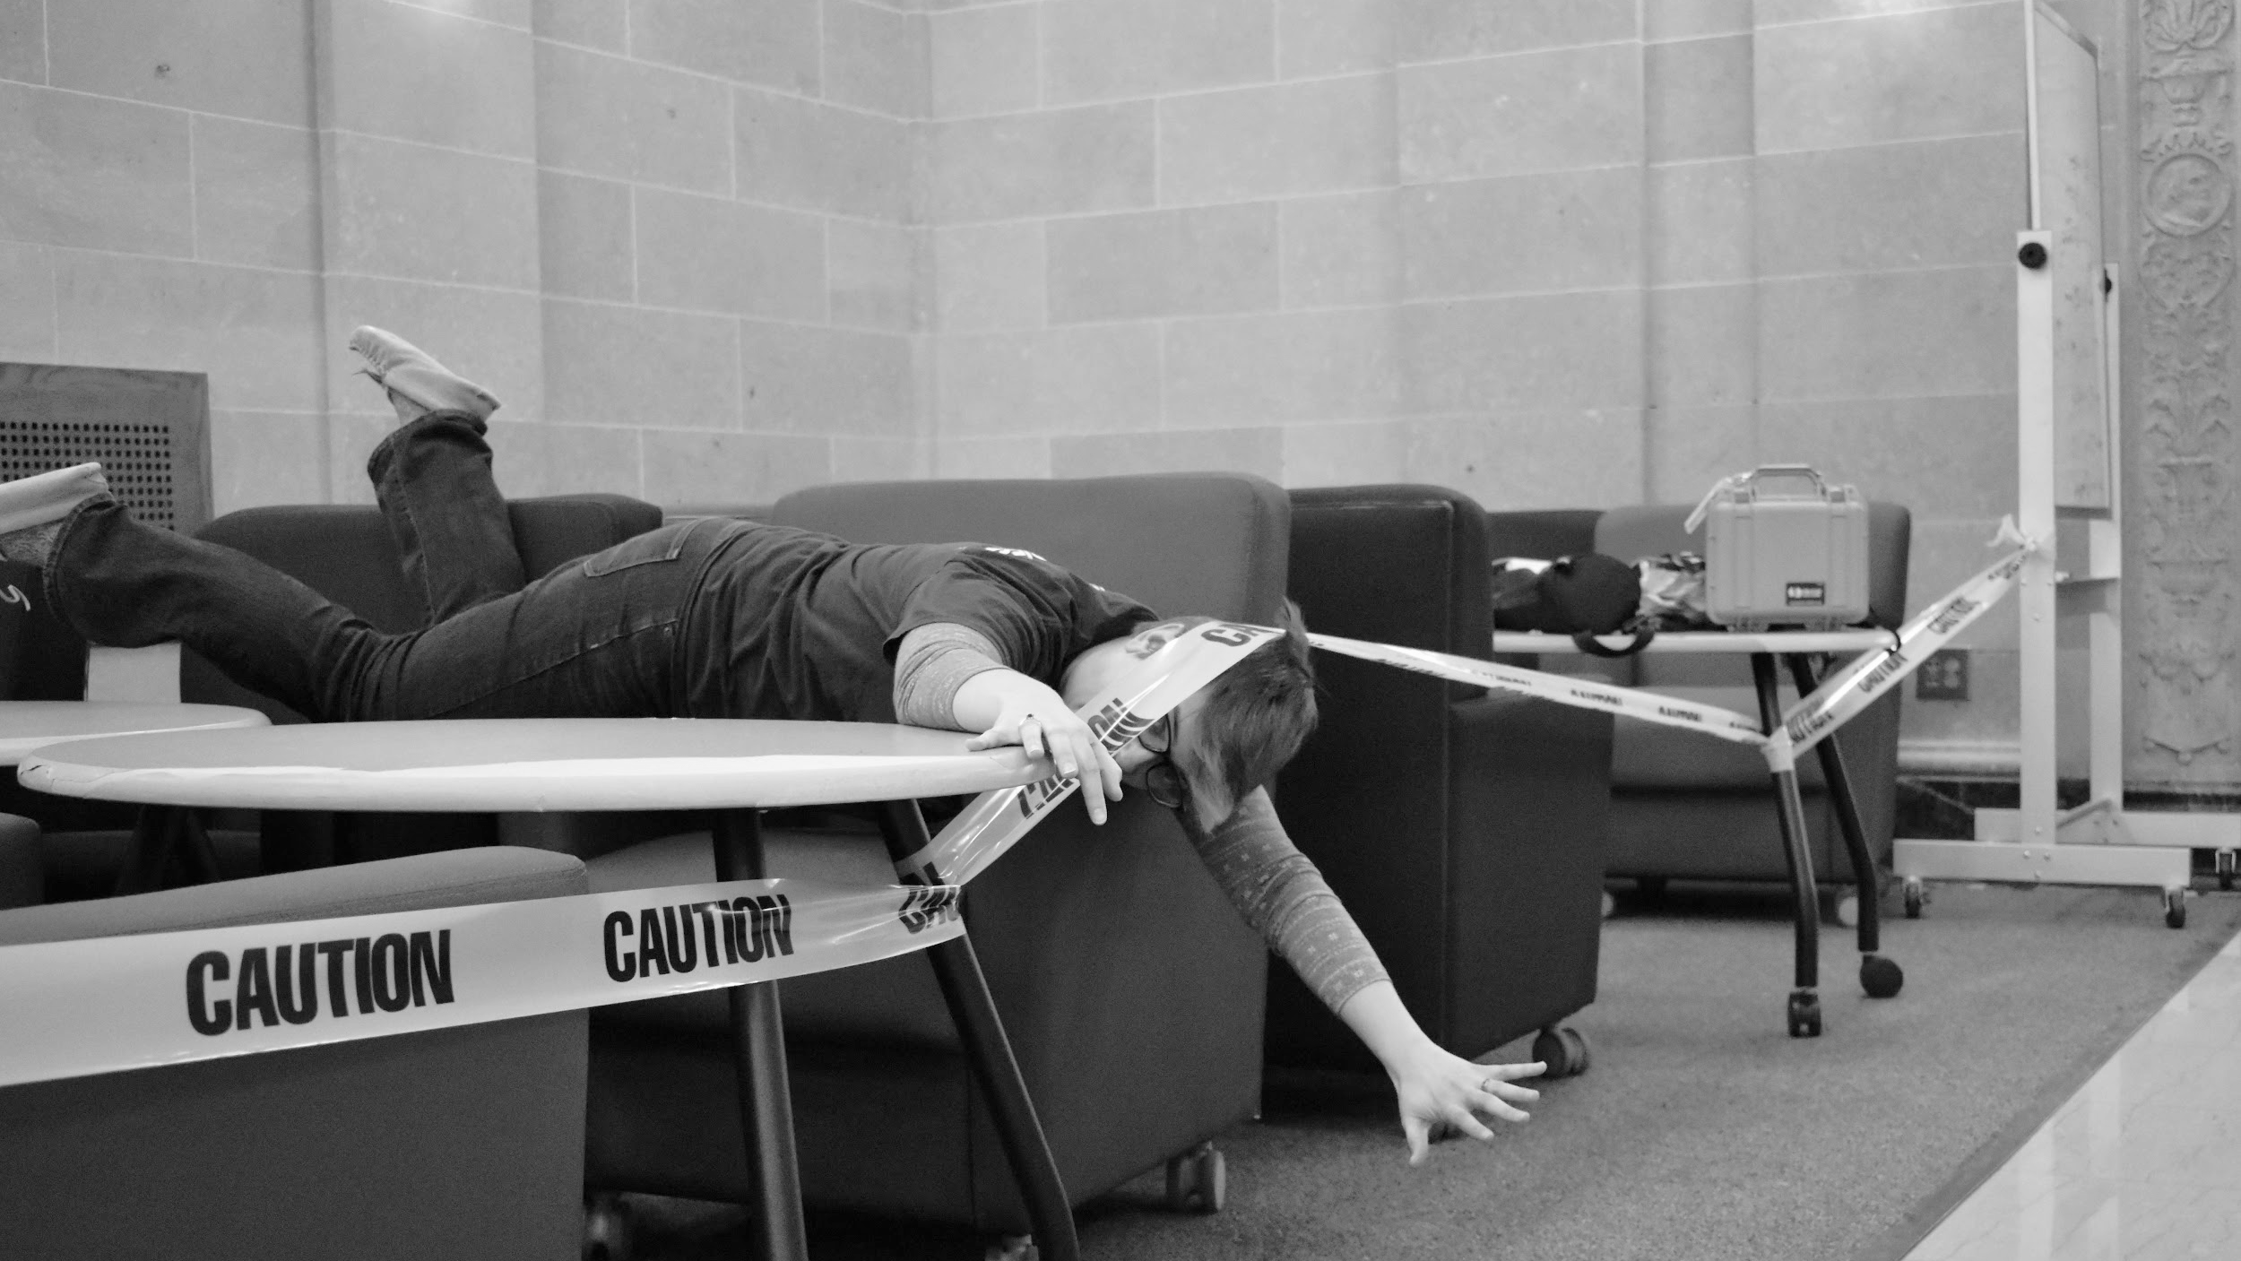
We don’t have time and
can’t handle complexity.
Notes:
However, the space does require updates and thoughtful redesign. Over time, furniture was moved wherever there was space, not necessarily where students would find it valuable. Some spaces had been neglected because of the restrictions on moving the heaviest furniture or simply not knowing how to take the first step. There was not any data that helped to address these problems, guide decisions, or aid in determining priorities. Walter is large enough that it can provide both social and communal spaces desired by users, but striking a good balance had to be achieved by careful observation of the activity occurring in the spaces.

Slide 8
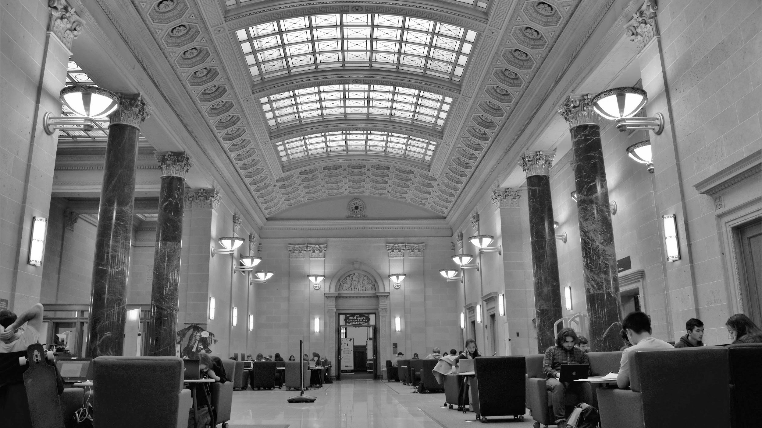
Our library is a historic building & hard to modify.
Notes:
Walter Library is a library on the University of Minnesota Twin Cities campus that has undergone a significant transition from collection storehouse to student learning space and contains many spaces that support collaboration, communal use, and semi-private work. Opened to the public in 1924, Walter Library is the oldest library on campus. The lobby and second floor have marble walls, beautiful ornate ceilings, marble columns, and frescoes above the door ways. The library houses the physical science and engineering collections but much of the collections were moved to storage during a renovation completed in 2002. It has huge areas devoted to individual and group study space and is centrally located on campus, which contributes to the large numbers of students who use the library.
The ornate grandeur and historical status of these areas mean there are restrictions on what staff can and cannot do to modify the space. The major study areas on the second floor are huge rooms with vaulted ceilings. Two of these rooms contain heavy wooden tables that are hard-wired into the floor and require a crane to move. Careful thought is required before asking to change things in Walter.

Slide 9
Are we improving the space for our users?
Or just pointlessly moving stuff around?
Notes:
A data collection project was designed to gain a better understanding of how people are using the spaces and furniture in Walter Library so informed decisions could be made about the spaces and a more strategic and iterative approach to designing library spaces based on user needs could be taken.

Slide 10
Making library spaces talk
How we made our library space talk
What our library told us
How we used the data
Notes:
How we made our (weird) library space talk (Methods section)

Slide 11
Requirements:
Repeatable method
Actionable results
Staff won’t hate doing it / hate us

Slide 12
Number of counts = We like 3’s!
3 times 3 days 3 weeks
Notes:
Too many counts = too onerous. We didn’t need to know exact times, days, weeks that things were happening. We were sure we would not base the types of decisions this data would help us to make on any time data.

Slide 13
Counts by room
and furniture type
Notes:
Most of the work we wanted to do revolved around moving and purchasing furniture. THIS is the data we really wanted to collect. What furniture was being used and where.

Slide 14
Some questions are worth asking
Number of people sitting at a computer station but not using the library computer.
Number of groups working in the area.
Number of people working while standing.
Number of upright monitors in use.
Location of upright monitors.
Notes:
We also wanted some information about how people were using the furniture or room. This is where we really had to pare down the data to be collected. It is very easy to want to know everything but each item you collect on takes more time for both the person collecting the data and the analysis at the end.

Slide 15
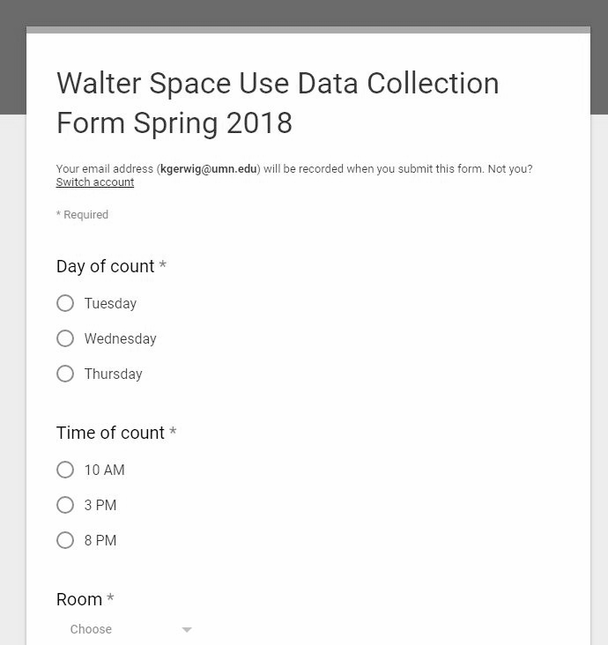
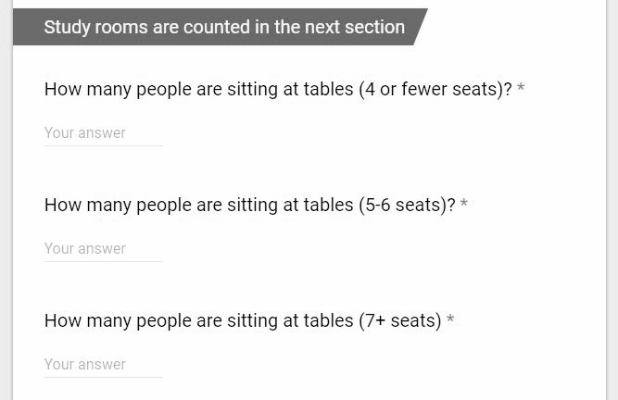
A data collection tool for everyone!
Google form AND paper form
Notes:
Plan for sustainability!
Which meant people needed to be invested, enthusiastic, and comfortable. I created a Google form and a print form. This made data collectors happy.
The form for Fall semester had issues which we will talk about later.
TEST the form!!! Have the people who will be collecting the data do a trial run or two. Their feedback will only make the tool better and the data more reliable.
For reliable data everyone MUST be on the same page. Clear definitions help. Instructions and cues in the form help.
Keep in mind - each word you add to a form creates the possibility for misunderstanding and confusion.
Keep it simple. Make it flow. Make it clear. Do the work for the data collectors when possible.

Slide 16
Making library spaces talk
How we made our library space talk
What our library told us
How we used the data
Notes:
What our library told us (Findings)

Slide 17
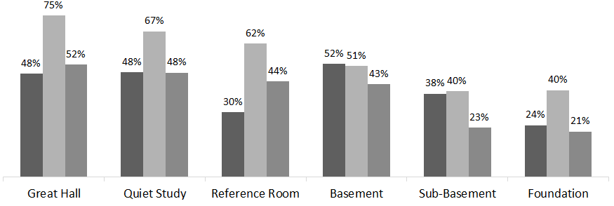
The library is busiest in the afternoon and is never truly “full.”
Average occupancy rates
at 10am, 3pm, & 8pm
Fall 2017 (top)
Spring 2018 (bottom)
3pm spikes

Slide 18
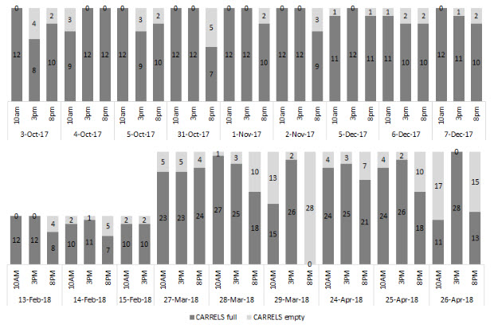
But some furniture WAS often full regardless of time of day.
Use of study carrels
in the Quiet Study Room
occupied and unoccupied
Fall 2017 (top) &
Spring 2018 (bottom)
Full seats
Full seats

Slide 19
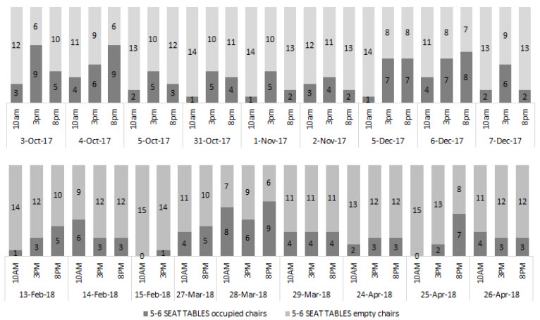
Some furniture was mostly empty.
Empty seats
Use of group tables
in the Foundation level
occupied and unoccupied
Fall 2017 (top) &
Spring 2018 (bottom)
Empty seats

Slide 20
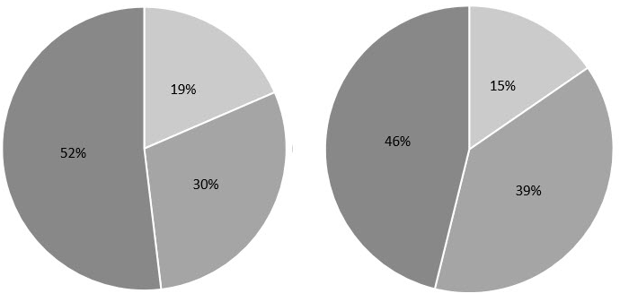
Some spaces were great for group work.
How often we saw
3+groups, 1-2 groups, or
0 groups
working in the Great Hall.
Fall 2017 (left)
Spring 2018 (right)
The Great Hall almost always had several groups studying together

Slide 21
Making library spaces talk
How we made our library space talk
What our library told us
How we used the data
Notes:
How we used the data (Implications)

Slide 22
We have enough evidence to make decisions
with enough detail to tell a story,
but are not overwhelmed with either.
Notes:
This lightweight space assessment method was created to provide detailed enough information to enable evidence-based decision-making, but not so complex or time-consuming that staff would not want to participate in data collection or feel ill equipped to analyze or use the data. The descriptive headcounts are a simple form of space assessment that library staff can complete in under thirty minutes. The method produces data that a staff member with intermediate Excel skills can explore and transform into a story. The added metadata about furniture type, room, time, and group activity provides a balanced level of granularity to the data. The data can answer big picture questions about library use and inform individual decisions about the arrangement, location, and amount of furniture in a space.

Slide 23
Every semester the data gives us new ideas to improve our user spaces.
Notes:
We shifted study carrels into the Quiet Study Room and saw students flock to them.
Tables were brought up from downstairs, adding seats to the 2nd floor. We’re collecting data on them again.
We set up an experimental “mini Great Hall” in a quieter room to see if groups would work there.

Slide 24
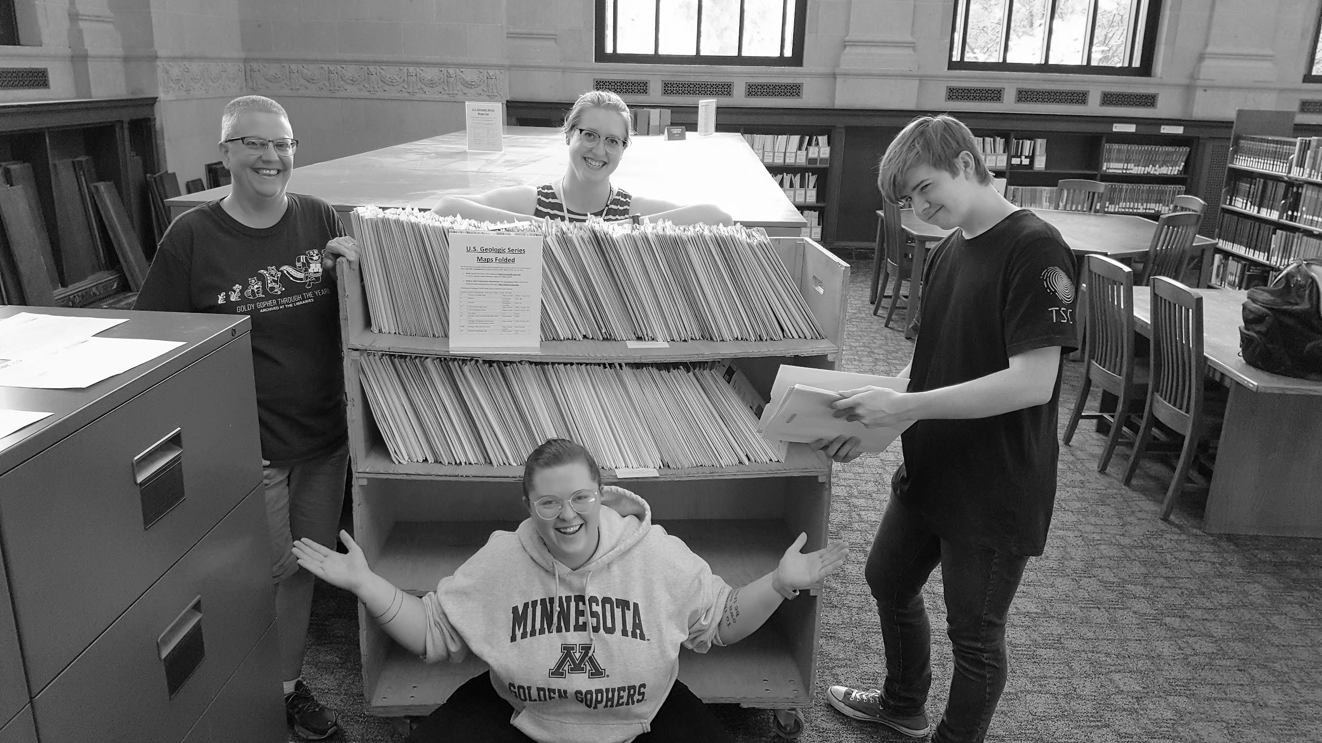
Every semester our colleagues help improve the instrument.

Slide 25
Some questions are no longer worth asking
Number of people sitting at a computer station but not using the library PC.
Number of groups working in the room.
Number of people working while standing.
Number of upright monitors in use.
Location of upright monitors.

Slide 26
Staff are better connected
to all of our user spaces.

Slide 27
We see a return on our investment of time right away.

Slide 28
We know our limits.

Slide 29
Thank you!
Kat Gerwig kgerwig@umn.edu
Carolyn Bishoff cbishoff@umn.edu

